Slide 1

Neural Network Programming
Mrinal Wahal
Research Park, IIT Madras

Slide 2
The Peculiar Case Against Mathematics

Slide 3
Introduction to
Machine Learning
Or so they say.

Slide 5
Explaining Neural Network programming to a 5 year old.
Okay, maybe a little older than that.

Slide 7
Housing Price Prediction
price
size of house

Slide 8
Housing Price Prediction

Slide 9
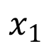
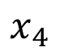
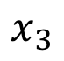
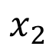
Housing Price Prediction
size
$$x_{1}$$
#bedrooms
$$x_{2}$$
y
zip code
$$x_{3}$$
wealth
$$x_{4}$$

Slide 10
XOR Function

Slide 11
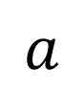
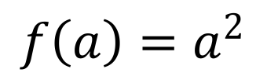
Intuition about derivatives
$$f\left(a\right)=a^{2}$$
$$a$$

Slide 13
Logistic Regression

Slide 14
Logistic Regression cost function
$\hat{y} = σ\left(w^{T}x +b\right)$, where $σ\left(z \right)=\frac{1}{1+e^{−z}}$
Given $\left\{{(x}^{(1)},y^{(1)}\text{)}\text{,}\text{…}\text{,}{(x}^{(m)},y^{(m)}\text{)}\right\},$want ${\hat{y}}^{(i)}≈y^{\left(i\right)}$.
Loss (error) function:

Slide 15
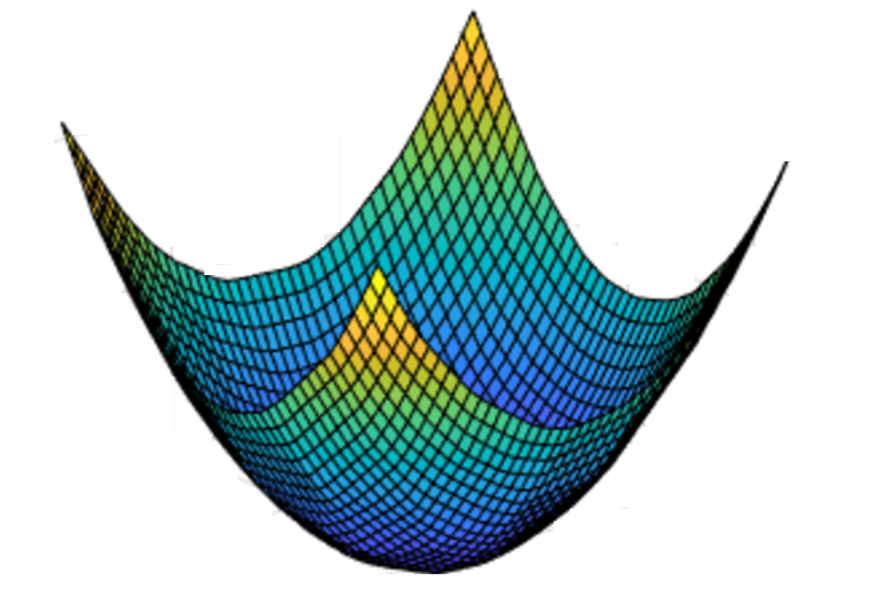
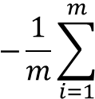
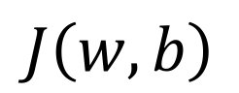
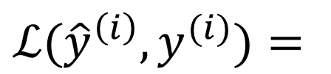
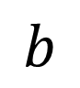
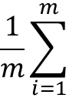
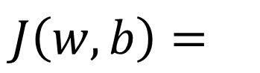


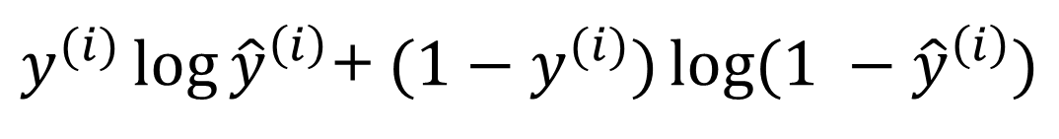

Gradient Descent
Recap: $\hat{y}= σ\left(w^{T}x+b\right)$, $σ\left(z\right)=\frac{1}{1+e^{−z}}$
$$\frac{1}{m}\sum_{i=1}^{m}{ }$$
$ℒ({\hat{y}}^{\left(i\right)},y^{(i)})$ $=$
$$−\frac{1}{m}\sum_{i=1}^{m}{ }$$
$$J\left(w,b\right)=$$
$y^{(i)}\log{{\hat{y}}^{\left(i\right)}}$+ $({1−y}^{(i)})\log{(1 −{\hat{y}}^{\left(i\right)})}$
Want to find $w,b$ that minimize $J\left(w,b\right)$
$$J\left(w,b\right)$$
$$b$$
$$w$$

Slide 16
One hidden layer
Neural Network
Neural Network
Representation

Slide 17
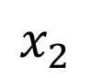
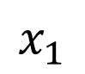
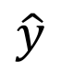
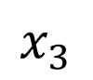
Neural Network Representation
$$x_{1}$$
$$x_{2}$$
$$\hat{y}$$
$$x_{3}$$

Slide 18
One hidden layer
Neural Network
Computing a
Neural Network’s
Output

Slide 19
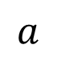
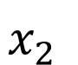

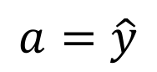
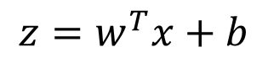
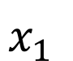
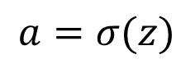
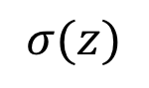
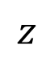
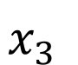
Neural Network Representation
$$x_{1}$$
$$x_{1}$$
$$x_{2}$$
$$σ(z)$$
$$a=\hat{y}$$
$$x_{2}$$
$$\hat{y}$$
$$w^{T}x+b$$
$$z$$
$$a$$
$$x_{3}$$
$$x_{3}$$
$$z=w^{T}x+b$$
$$a=σ(z)$$

Slide 20
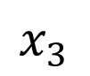
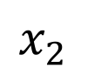
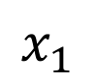
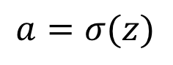


Neural Network Representation
$$x_{1}$$
$$x_{1}$$
$$x_{2}$$
$$σ(z)$$
$$a=\hat{y}$$
$$x_{2}$$
$$\hat{y}$$
$$w^{T}x+b$$
$$z$$
$$a$$
$$x_{3}$$
$$x_{3}$$
$$z=w^{T}x+b$$
$$x_{1}$$
$$a=σ(z)$$
$$x_{2}$$
$$\hat{y}$$
$$x_{3}$$

Slide 21
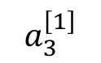
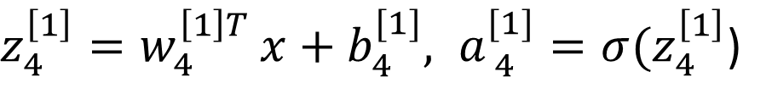
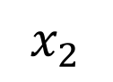
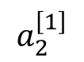
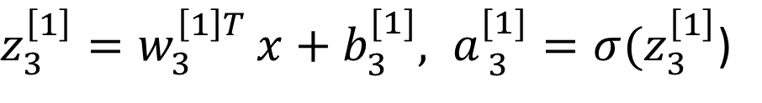
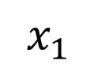
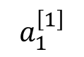
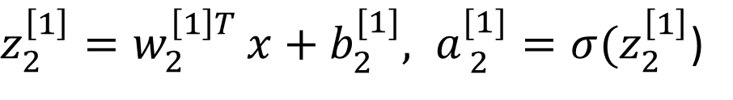
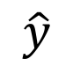
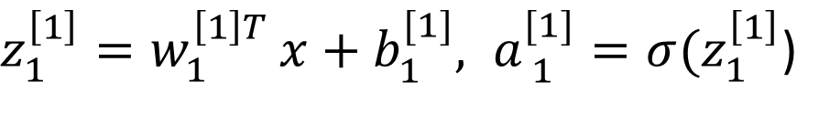
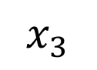
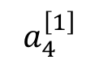
Neural Network Representation
$$a_{1}^{\left[1\right]}$$
$z_{1}^{\left[1\right]}=w_{1}^{{\left[1\right]T}^{ }}x+b_{1}^{[1]}, a_{ 1}^{[1]}=σ(z_{1}^{\left[1\right]}$)
$$x_{1}$$
$$a_{2}^{\left[1\right]}$$
$z_{2}^{\left[1\right]}=w_{2}^{{\left[1\right]T}^{ }}x+b_{2}^{[1]}, a_{ 2}^{[1]}=σ(z_{2}^{\left[1\right]}$)
$$x_{2}$$
$$\hat{y}$$
$$a_{3}^{\left[1\right]}$$
$z_{3}^{\left[1\right]}=w_{3}^{{\left[1\right]T}^{ }}x+b_{3}^{[1]}, a_{ 3}^{[1]}=σ(z_{3}^{\left[1\right]}$)
$$x_{3}$$
$$a_{4}^{\left[1\right]}$$
$z_{4}^{\left[1\right]}=w_{4}^{{\left[1\right]T}^{ }}x+b_{4}^{[1]}, a_{ 4}^{[1]}=σ(z_{4}^{\left[1\right]}$)

Slide 22
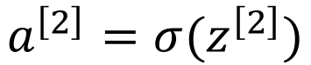
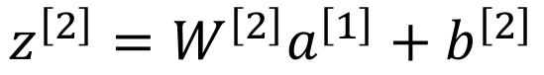
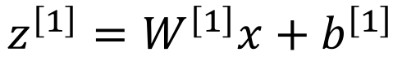
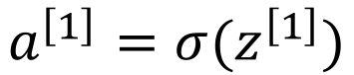
Neural Network Representation learning
$$a_{1}^{\left[1\right]}$$
Given input x:
$$x_{1}$$
$$a_{2}^{\left[1\right]}$$
$$z^{\left[1\right]}=W^{\left[1\right]}x+b^{\left[1\right]}$$
$$x_{2}$$
$$\hat{y}$$
$$a_{3}^{\left[1\right]}$$
$$x_{3}$$
$$a^{\left[1\right]}=σ(z^{\left[1\right]})$$
$$a_{4}^{\left[1\right]}$$
$$z^{\left[2\right]}=W^{\left[2\right]}a^{\left[1\right]}+b^{\left[2\right]}$$
$$a^{\left[2\right]}=σ(z^{\left[2\right]})$$

Slide 23
Forward Propagation Implementation in Python

Slide 24
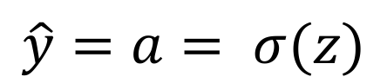
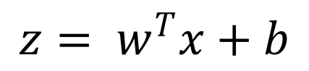
Logistic regression recap
$$z= w^{T}x+b$$
$$\hat{y}=a= σ(z)$$
$$ℒ\left(a,y\right)=−(y\log{(a)+(1−y)\log{(1−a))}}$$

Slide 25
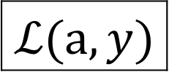






Logistic regression derivatives
$$x_{1}$$
$$w_{1}$$
$$x_{2}$$
$$z= w_{1}x_{1}+w_{2}x_{2}+b$$
$$a= σ(z)$$
$$ℒ(a,y)$$
$$w_{2}$$
b

Slide 26
Logistic regression on m examples

Slide 27
One hidden layer
Neural Network
Activation functions

Slide 28


Pros and cons of activation functions
a
a
x
z
$$a= \frac{1}{1+e^{−z}}$$
sigmoid:
a
a
z
z

Slide 29
One hidden layer
Neural Network
Derivatives of
activation functions

Slide 30

Sigmoid activation function
a
$$g(z)= \frac{1}{1+e^{−z}}$$
z

Slide 31

Tanh activation function
a
$$g(z)=tanh(z){ }$$
z

Slide 32
ReLU and Leaky ReLU
a
a
z
z
ReLU
Leaky ReLU

Slide 33
Deep Neural Networks
Why deep
representations?

Slide 34




Intuition about deep representation
$$\hat{y}$$

Slide 35

Basics of Neural Network Programming
Vectorization
deeplearning.ai

Slide 36
What is vectorization?

Slide 37
Neural network programming guideline
Whenever possible, avoid explicit for-loops.

Slide 38

Vectors and matrix valued functions
Say you need to apply the exponential operation on every element of a matrix/vector.
$$v= \left[\begin{matrix}v_{1} \\ ⋮ \\ v_{n}\end{matrix}\right]$$
u = np.zeros((n,1))
for i in range(n):
u[i]=math.exp(v[i])

Slide 39
One hidden layer
Neural Network
Random Initialization

Slide 40






What happens if you initialize weights to zero?
$$x_{1}$$
$$a_{1}^{[1]}$$
$$a_{1}^{[2]}$$
$$\hat{y}$$
$$x_{2}$$
$$a_{2}^{[1]}$$

Slide 41
Random initialization
$$x_{1}$$
$$a_{1}^{[1]}$$
$$a_{1}^{[2]}$$
$$\hat{y}$$
$$x_{2}$$
$$a_{2}^{[1]}$$

Slide 42
Deep Neural Networks
Getting your matrix
dimensions right

Slide 43




Parameters $W^{[l]}$ and $b^{[l]}$
$$x_{1}$$
$$\hat{y}$$
$$x_{2}$$

Slide 44
Vectorized implementation
$$x_{1}$$
$$\hat{y}$$
$$x_{2}$$

Slide 45
Useless Stuff

Slide 46
Deep Neural Networks
What does this
have to do with
the brain?

Slide 47












Forward and backward propagation
For example the first activation functions could be ReLU and the last one
Could be sigmoid
$$Z^{[1]}=W^{[1]}X+b^{[1]}$$
$${dZ}^{[L]}=A^{[L]}−Y$$
$$A^{[1]}=g^{\left[1\right]}(Z^{\left[1\right]})$$
$$dW^{[L]}=\frac{1}{m}dZ^{\left[L\right]}A^{{\left[L\right]}^{T}}$$
$$Z^{[2]}=W^{[2]}A^{[1]}+b^{[2]}$$
$$db^{[L]}=\frac{1}{m}np. sum(dZ^{\left[L\right]},axis=1, keepdims=True)$$
$$A^{[2]}=g^{\left[2\right]}(Z^{\left[2\right]})$$
…
$${dZ}^{[L−1]}=dW^{{\left[L\right]}^{T}}dZ^{\left[L\right]}{g^{′}}^{\left[L\right]}(Z^{\left[L−1\right]})$$
$$A^{[L]}=g^{\left[L\right]}\left(Z^{\left[L\right]}\right)=\hat{Y}$$
…
$${dZ}^{[1]}=dW^{{\left[L\right]}^{T}}dZ^{\left[2\right]}{g^{′}}^{\left[1\right]}(Z^{\left[1\right]})$$
$$dW^{[1]}=\frac{1}{m}dZ^{\left[1\right]}A^{{\left[1\right]}^{T}}$$
$$db^{[1]}=\frac{1}{m}np. sum(dZ^{\left[1\right]},axis=1, keepdims=True)$$
Align left/vertical will mess up the equations here

Slide 48
Binary Classification
1 (cat) vs 0 (non cat)
Blue
Green
Red

Slide 49
Notation

Slide 50
Deep Neural Networks
Parameters vs
Hyperparameters

Slide 51
What are hyperparameters?
Parameters: $W^{\left[1\right]} ,{ b}^{\left[1\right] }, W^{\left[2\right]} ,b^{\left[2\right] },W^{\left[3\right] }, b^{\left[3\right] }…$

Slide 52

Applied deep learning is a very empirical process
Idea
cost $J$
Experiment
Code
# of iterations

Slide 53
Heavy Applications of Deep Learning

Slide 54
Project Demo

Slide 55
Next Level Research Scopes

Slide 56
Resources
PDFs
Keras
Python/R/Matlab

Slide 57
Ending Quote

